Slide 1
Parallel Jacobi Algorithm
Steven Dong
Applied Mathematics

Slide 2
Overview
Parallel Jacobi Algorithm
  Different data distribution schemes
    Row-wise distribution
    Column-wise distribution
    Cyclic shifting
    Global reduction
  Domain decomposition for solving Laplacian equations
Related MPI functions for parallel Jacobi algorithm and your project.

Slide 3
Linear Equation Solvers
Direct solvers
  Gauss elimination
  LU decomposition
Iterative solvers
  Basic iterative solvers
    Jacobi
    Gauss-Seidel
    Successive over-relaxation
  Krylov subspace methods
    Generalized minimum residual (GMRES)
    Conjugate gradient

Slide 4
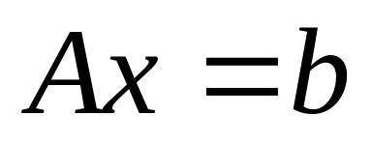
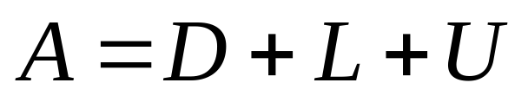
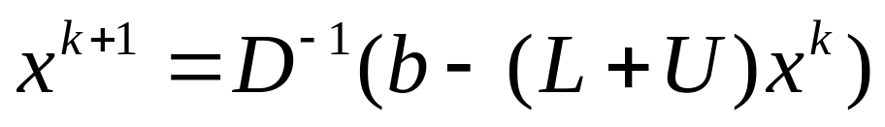
Sequential Jacobi Algorithm
D is diagonal matrix
L is lower triangular matrix
U is upper triangular matrix

Slide 5
Parallel Jacobi Algorithm: Ideas
Shared memory or distributed memory:
  Shared-memory parallelization very straightforward
  Consider distributed memory machine using MPI
Questions to answer in parallelization:
  Identify concurrency
  Data distribution (data locality)
    How to distribute coefficient matrix among CPUs?
    How to distribute vector of unknowns?
    How to distribute RHS?
  Communication: What data needs to be communicated?
Want to:
  Achieve data locality
  Minimize the number of communications
  Overlap communications with computations
  Load balance

Slide 6
Row-wise Distribution
A
x
b
m
A: n x n
m = n/P
P is number of CPUs
m
=
…
n
Assume dimension of matrix can be divided by number of CPUs
Blocks of m rows of coefficient matrix distributed to different CPUs;
Vector of unknowns and RHS distributed similarly

Slide 7
Data to be Communicated
A
x
b
m
Cpu 0
m
Cpu 1
=
…
n
Already have all columns of matrix A on each CPU;
Only part of vector x is available on a CPU; Cannot carry out matrix vector multiplication directly;
Need to communicate the vector x in the computations.

Slide 8
How to Communicate Vector X?
Gather partial vector x on each CPU to form the whole vector; Then matrix-vector multiplication on different CPUs proceed independently. (textbook)
Need MPI_Allgather() function call;
Simple to implement, but
  A lot of communications
  Does not scale well for a large number of processors.
R
E
D
R
E
D
R
E
D
R
E
D

Slide 9
How to Communicate X?
Another method: Cyclic shift
  Shift partial vector x upward at each step;
  Do partial matrix-vector multiplication on each CPU at each step;
  After P steps (P is the number of CPUs), the overall matrix-vector multiplication is complete.
Each CPU needs only to communicate with neighboring CPUs
  Provides opportunities to overlap communication with computations
Detailed illustration …

Slide 10
a11
a12
a13
a14
x1
a11
a12
a13
a14
x2
(1)
a21
a22
a23
a24
x2
(2)
a21
a22
a23
a24
x3
a31
a32
a33
a34
x3
a31
a32
a33
a34
x4
a41
a42
a43
a44
x4
a41
a42
a43
a44
x1
a11*x1 + a12*x2 + a13*x3 + a14*x4
a21*x1 + a22*x2 + a23*x3 + a24*x4
a31*x1 + a32*x2 + a33*x3 + a34*x4
a41*x1 + a42*x2 + a43*x3 + a44*x4
Cpu 0
a11*x1 + a12*x2 + a13*x3 + a14*x4
a21*x1 + a22*x2 + a23*x3 + a24*x4
a31*x1 + a32*x2 + a33*x3 + a34*x4
a41*x1 + a42*x2 + a43*x3 + a44*x4
Cpu 1
Cpu 2
Cpu 3
a11
a12
a13
a14
x3
a11
a12
a13
a14
x4
(3)
a21
a22
a23
a24
x4
(4)
a21
a22
a23
a24
x1
a31
a32
a33
a34
x1
a31
a32
a33
a34
x2
a41
a42
a43
a44
x2
a41
a42
a43
a44
x3
a11*x1 + a12*x2 + a13*x3 + a14*x4
a21*x1 + a22*x2 + a23*x3 + a24*x4
a31*x1 + a32*x2 + a33*x3 + a34*x4
a41*x1 + a42*x2 + a43*x3 + a44*x4
a11*x1 + a12*x2 + a13*x3 + a14*x4
a21*x1 + a22*x2 + a23*x3 + a24*x4
a31*x1 + a32*x2 + a33*x3 + a34*x4
a41*x1 + a42*x2 + a43*x3 + a44*x4

Slide 11
Overlap Communications with Computations
Communications:
  Each CPU needs to send its own partial vector x to upper neighboring CPU;
  Each CPU needs to receive data from lower neighboring CPU
Overlap communications with computations: Each CPU does the following:
  Post non-blocking requests to send data to upper neighbor to to receive data from lower neighbor; This returns immediately
  Do partial computation with data currently available;
  Check non-blocking communication status; wait if necessary;
  Repeat above steps

Slide 12
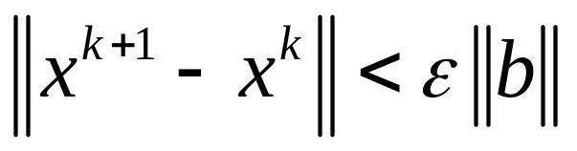
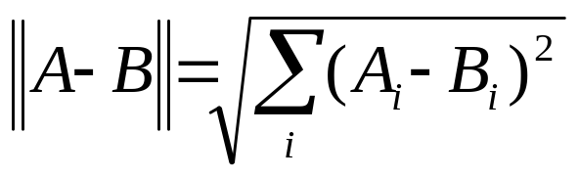
Stopping Criterion
Computing norm requires information of the whole vector;
Need a global reduction (SUM) to compute the norm using MPI_Allreduce or MPI_Reduce.

Slide 13
Column-wise Distribution
m
m
…
n
=
A
x
b
Blocks of m columns of coefficient matrix A are distributed to different CPUs;
Blocks of m rows of vector x and b are distributed to different CPUs;

Slide 14
Data to be Communicated
m
m
…
n
=
A
x
b
Already have coefficient matrix data of m columns, and a block of m rows of vector x;
So a partial A*x can be computed on each CPU independently.
Need communication to get whole A*x;

Slide 15
How to Communicate
After getting partial A*x, can do global reduction (SUM) using MPI_Allreduce to get the whole A*x. So a new vector x can be calculated.
Another method: Cyclic shift
  Shift coefficient matrix left-ward and vector of unknowns upward at each step;
  Do a partial matrix-vector multiplication, and subtract it from the RHS;
  After P steps (P is number of CPUs), matrix-vector multiplication is completed and subtracted from RHS; Can compute new vector x.
Detailed illustration …

Slide 16
a11
a12
a13
a14
x1
b1
a12
a13
a14
a11
x2
b1
(1)
a21
a22
a23
a24
x2
=
b2
(2)
a22
a23
a24
a21
x3
b2
=
a31
a32
a33
a34
x3
b3
a32
a33
a34
a31
x4
b3
a41
a42
a43
a44
x4
b4
a42
a43
a44
a41
x1
b4
b1 - a11*x1 - a12*x2 - a13*x3 - a14*x4
b2 - a21*x1 - a22*x2 - a23*x3 - a24*x4
b3 - a31*x1 - a32*x2 - a33*x3 - a34*x4
b4 - a41*x1 - a42*x2 - a43*x3 - a44*x4
b1 - a11*x1 - a12*x2 - a13*x3 - a14*x4
b2 - a21*x1 - a22*x2 - a23*x3 - a24*x4
b3 - a31*x1 - a32*x2 - a33*x3 - a34*x4
b4 - a41*x1 - a42*x2 - a43*x3 - a44*x4
a13
a14
a11
a12
x3
b1
a14
a11
a12
a13
x4
b1
(3)
a23
a24
a21
a22
x4
b2
(4)
a24
a21
a22
a23
x1
b2
=
=
a33
a34
a31
a32
x1
b3
a34
a31
a32
a33
x2
b3
a43
a44
a41
a42
x2
b4
a44
a41
a42
a43
x3
b4
b1 - a11*x1 - a12*x2 - a13*x3 - a14*x4
b2 - a21*x1 - a22*x2 - a23*x3 - a24*x4
b3 - a31*x1 - a32*x2 - a33*x3 - a34*x4
b4 - a41*x1 - a42*x2 - a43*x3 - a44*x4
b1 - a11*x1 - a12*x2 - a13*x3 - a14*x4
b2 - a21*x1 - a22*x2 - a23*x3 - a24*x4
b3 - a31*x1 - a32*x2 - a33*x3 - a34*x4
b4 - a41*x1 - a42*x2 - a43*x3 - a44*x4

Slide 17
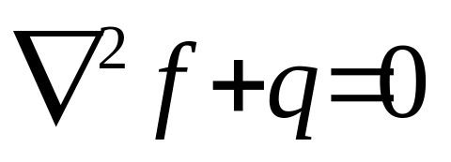
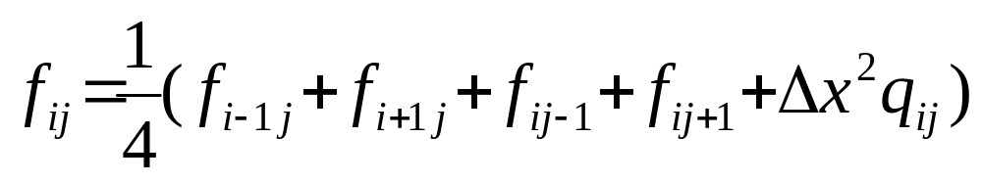
Solving Diffusion Equation
How do we solve it in parallel in practice?
Need to do domain decomposition.

Slide 18
Domain Decomposition
cpu 0
cpu 1
…
Column-wise decomposition
Boundary points depend on data from neighboring CPU
  During each iteration, need send own boundary data to neighbors, and receive boundary data from neighboring CPUs.
Interior points depend only on data residing on the same CPU (local data).
y
x

Slide 19
Overlap Communication with Computations
Compute boundary points and interior points at different stages;
Specifically:
  At the beginning of an iteration, post non-blocking send to and receive from requests for communicating boundary data with neighboring CPUs;
  Update values on interior points;
  Check communication status (should complete by this point), wait if necessary;
  Boundary data received, update boundary points;
  Begin next iteration, repeat above steps.

Slide 20
Other Domain Decompositions
1D decomposition
2D decomposition

Slide 21
Related MPI Functions for Parallel Jacobi Algorithm
MPI_Allgather()
MPI_Isend()
MPI_Irecv()
MPI_Reduce()
MPI_Allreduce()

Slide 22
MPI Programming Related to Your Project
Parallel Jacobi Algorithm
Compiling MPI programs
Running MPI programs
Machines: www.cascv.brown.edu

